Slide 1
Target Case Presentation
Andrei Bailes, Rose Donohoo, Dove Leatherwood, Isaiah Sarria

Slide 2

Target History Timeline
1962
The 1st SuperTarget store opens in Omaha, Nebraska
2000
Dayton-Hudson changes name to Target Corporation
Target Grosses $30 billion
2005
Target Spends $1 billion on advertising
* 2% of their 2005 Sales
1999
Target.com launches
Target Grosses $52.6 billion
* 12.1% Growth from 2000
1995
Target announces plans to open about 100 stores annually, indefinitely
The Dayton Company opens the 1st Target store in Roseville, Minnesota

Slide 3
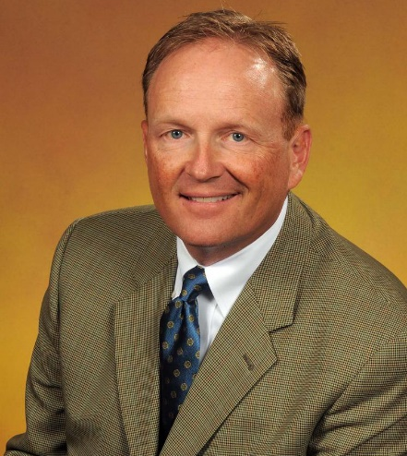
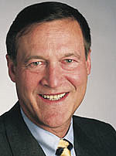
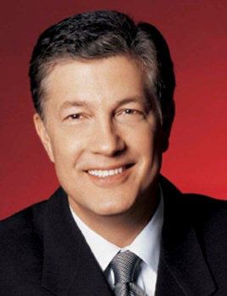
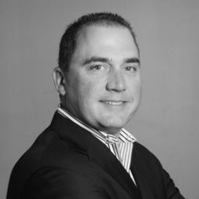
Capital Expenditure Committee (CEC)
Target Executives
John Griffith, 44
Senior VP, Property Development
02/2000 – 02/2005
Promoted to EVP, Property Development
02/2005
Robert Ulrich, 62
Dayton-Hudson Merchandising Trainee
1967
Promoted to CEO of Target Stores
1987
Promoted to CEO of Dayton-Hudson
1994
Gregg Steinhafel, 50
Target Stores Merchandising Trainee
1979
Declared President
1999
Troy Risch, 37
Promoted to EVP, Stores
09/2006

Slide 4
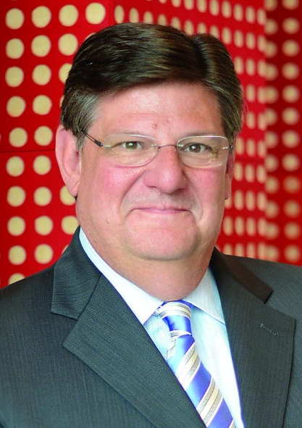
Capital Expenditure Committee (CEC)
Notable Management
Identified 5/10 Capital Project Requests (CPRs) with positive NPVs.
Gopher Place, Whalen Court,
The Barn, Goldie’s Square &
Stadium Remodel
Recognized the need to rank the 5 CPRs for decision-making at the upcoming CEC meeting.
Questioned if projected NPVs justified the necessary investment.
Target Executives
Doug Scovanner, 49
Dayton-Hudson CFO
Prior to 2000
Promoted to Target CFO and EVP
02/2000

Slide 5
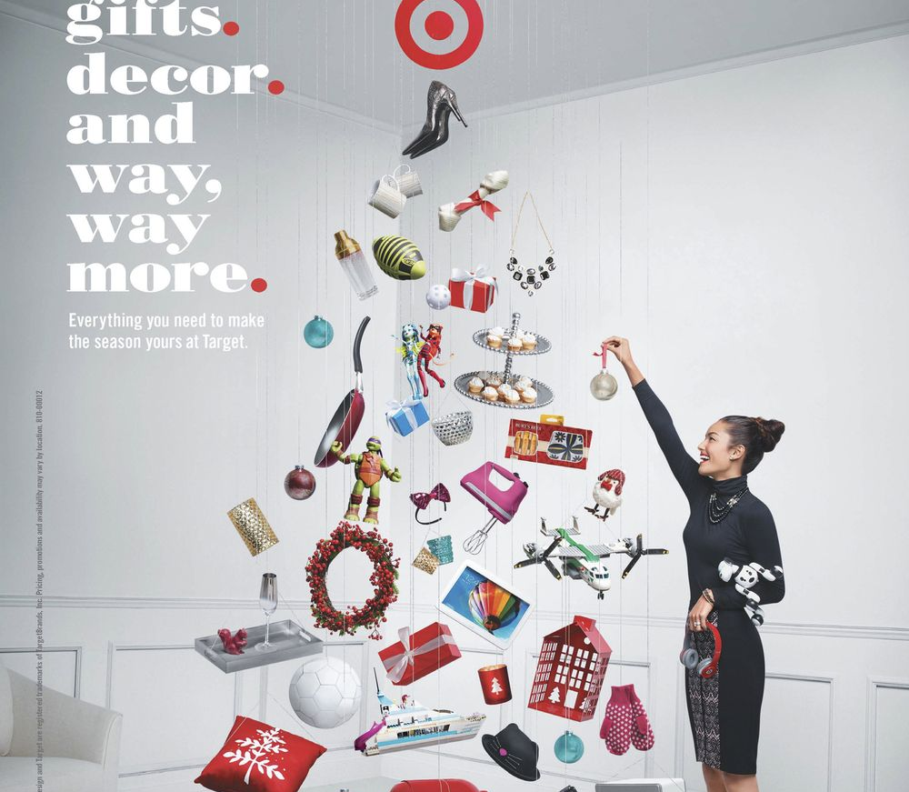
Company Strategy and Competitors
Primary Competitors - Sears(formerly), JCPenney, Walmart, & Costco.
Revenue strategy primarily focuses on advertisement campaigns, store experience, and store credit cards.
Company heavily focuses on customer experience to appeal to a “higher-class” audience.

Slide 6

Executive Summary
The CEC is the Capital Expenditure Committee.
CPRs (Capital Expenditure Requests) would be sent to the CEC for approval.
Of 10 project presented at the November CEC meeting, 4 store openings 1 remodel were debated.
In this analysis we will use BCA to demonstrate how Target should invest into the new store in Whalen Court.

Slide 7
Important Data

Slide 8
Gopher Place & Whalen Court
Gopher place
Investment: $23,000
Best Case NPV: 16,800
IRR: 12.3%
Will help maintain presence in the market area
Whalen court
Investment: $119,300
Best Case NPV: $25,900
IRR: 9.8%
Urban center of a metropolitan area.

Slide 9
Stadium Remodel
Stadium remodel
Investment: $17,000
Best Case NPV: %15,700
IRR: 10.8%
Pre-established history in the area.

Slide 10
The Barn & Goldie's Square
The Barn
Investment: $13,000
Best Case NPV: $20,500
IRR: 16.4%
Low competition in the area
Goldie's square
Investment: $23,900
Best Case NPV: $300
IRR: 8.1%
Affluent customer base with easy brand awareness

Slide 11
Ranking Table
 | NPV rank | IRR rank | PI rank | Final decision rank
Gopher Place | 3 | 2 | 3 | 3
Whalen Court | 1 | 4 | 4 | 2
The Barn | 2 | 1 | 1 | 1
Goldie’s Square | 5 | 5 | 5 | 5
Stadium Remodel | 4 | 3 | 2 | 4

Slide 12
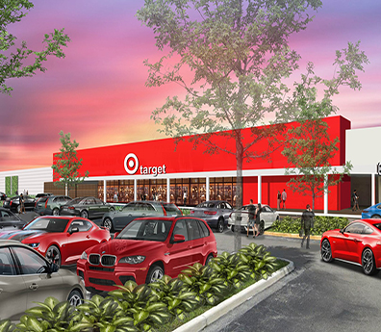
Suggestion for Whalen Court
Bustling metropolitan population of 632,000
45% of population is partially the target demographic
Highest NPV of alternatives
Easy brand awareness due to location
Rare opportunity
Notes:
Population of 632,000
45% of population is the target demographic (4+ years college)
Highest NPV of alternatives(despite largest initial investment)
Easy brand awareness due to location (reduction of advertisement expenses)
Rare opportunity (very high demand location)

